Slide 1
ITMD 536 Software Testing & Maintenance
Nazneen Hashmi
Call or Text: 312-498-8387
Office Hours by appointments
nhashmi@iit.edu

Slide 2
ITMD 536 Software Testing & Maintenance
Chapter 1 Fundamentals of Testing

Slide 3
Objectives
Why is testing necessary?
What is testing?
Seven testing principles
Fundamental test process
The psychology of testing
Code of ethics
Review

Slide 4
Objectives
Finding defects, identifications of failures during test execution
Gaining confidence in the level of quality – highest risk pass
Providing information for decision making – entry and exit criteria
Preventing defects

Slide 5
Why is testing necessary?
Software systems context
The human (and other) causes of software defects
The role of testing, and its effect on quality
How much testing is enough?

Slide 6
Mistake(error),Defect(fault or Bug) Failure
Error (mistake) A human action that produces an incorrect result
Defect (bug, fault) A flaw in a component or system that can cause the component or system to fail to perform its required function- happens at execution
Failure Deviation of the component of system from its expected delivery, service or result

Slide 7
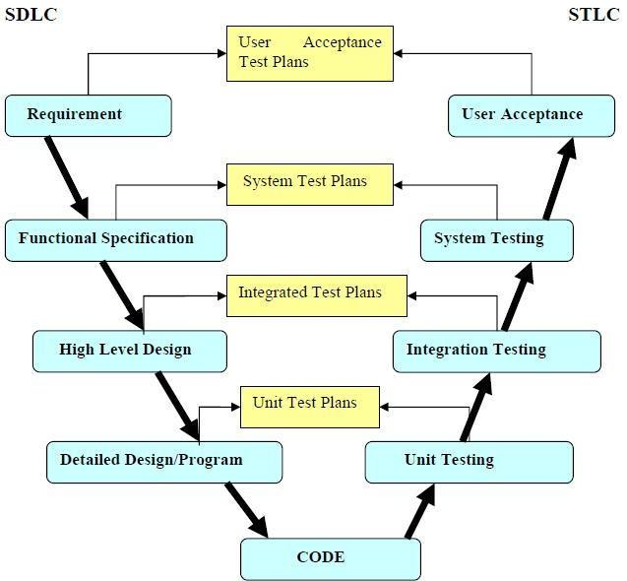

Slide 8
Quality and Risk
Quality: The degree to which a component, system or process meets specified requirements and/or user/customer needs and expectations
Risk: A factor that could result in future negative consequences; usually expressed as impact and likelihood

Slide 9
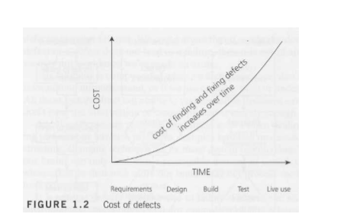

Slide 10
How much testing is sufficient
Business requirements are covered
Industry specific standards
Cover specific federal and state and international regulation for e.g.: Healthcare, Aviation, Finance

Slide 11
What is testing?
We make sure the quality is good or the software is acceptable
To discover any failures/errors/defects/bugs/issues or problems
What is the test objective: A reason or purpose for designing and executing a test

Slide 12
Testing Terminology
Confirmation testing, Debugging,
Requirements, Re-testing,
Review, Test case, Test control,
Test design, Specification,
Testing and Test objective

Slide 13
Test Planning
Scope, approach, resources, schedule and specific tasks are established
Identifies test items, in scope or out of scope
Roles and responsibilities assigned
Test design, techniques entry and exit criteria

Slide 14
Test Control
Test control is a test management task that deals with developing and applying a set of corrective actions to get a test project on track when monitoring shows a deviation from what was planned

Slide 15
Test Analysis
Test identifies what needs to be tested
Test conditions can be functions, transactions, feature, quality attributes, quality risks or structural elements

Slide 16
Test Case
A set of input values, execution preconditions, expected results and execution post conditions, developed for a particular objective or test condition, such as to exercise a particular program path or to verify compliance with a specific requirement

Slide 17
Test Design
A document specifying the test conditions (coverage items) for a test item, the detailed test approach and identifying the associated high level test cases
Test design helps you transform the general test conditions from the test plan into tangible test cases

Slide 18
Test Implementation
Carry out the remaining activities required to be ready for test execution such as:
Developing, prioritizing test procedures, creating test data, and setting up the test environment
Automated or manual

Slide 19
Test Execution
Test execution
Run tests against the test objects
Called Systems Test

Slide 20
Checking Results
Verify the actual test results
Outputs to screens,
Changes to data,
Reports and communication messages sent out
Compare expected results and document Pass/Fail

Slide 21
Evaluate Exit Criteria
Exit criteria are set of conditions that would allow some part of process to complete
Exit criteria is defined in test plan by working with project and product stakeholders

Slide 22
Test Results Reporting
Testing progress is reported continuously to the project holders
This report consist of details related to the status of the test project, the test process, and quality of the system under test. (Pass/Fail) %

Slide 23
Test Closure
Test closure involves collecting test process data related to the various completed test activities in order to consolidate our experience, re-usable testware, important facts and relevant metrics

Slide 24
Testing
The process consisting of all lifecycle activities, both static and dynamic, concerned with planning, preparation, and evaluation of software products determine that they satisfy specified requirements, to demonstrate that they are fit for purpose and to detect defects

Slide 25
Requirements
A condition or capability needed by a user to solve a problem or achieve an objective that must be met or possessed by a system or system component to satisfy a contract, standard, specification, or other formally imposed document

Slide 26
Review
An evaluation of a product project status to ascertain discrepancies from planned results and to recommend improvements.
Examples includes management review, informal review, technical review, inspection, and walkthrough.

Slide 27
Review
An evaluation of a product project status to ascertain discrepancies from planned results and to recommend improvements.
Examples includes management review, informal review, technical review, inspection, and walkthrough.

Slide 28
Debugging
The process of finding, analyzing and removing the causes of failures in software

Slide 29
Confirmation of testing (Re-testing)
Testing that runs test cases that failed the last time they were run, in order to verify the success of corrective actions.
Test the same test cases that failed previously and make sure that these test passes during the re-testing.

Slide 30
Seven Testing Principles
Principle 1
Principle 2
Principle 3
Principle 4
Principle 5
Principle 6
Principle 7
Testing shows presence of defects
Exhaustive testing is impossible
Early Testing
Defect clustering
Pesticide Paradox
Testing is context dependent
Absence-of-errors fallacy

Slide 31
Test Strategy
A high level description of the test levels to be performed and the testing within those levels for an organization or program (one or more projects).

Slide 32
Exhaustive Testing (Complete)
A test approach in which the test suite compromises all combinations of input values and preconditions
Infinity is impossible example Unix Operating system 4X more than molecules in universe
Focus on risk based testing
Follow requirement based testing

Slide 33
Early Testing
Early testing helps in finding defects are the early stage of development
Early testing is also cost effective
Focus on risk based testing
Follow requirement based testing

Slide 34
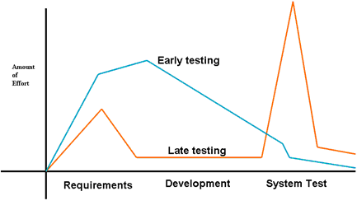
Early Testing

Slide 35
Defect Clustering
Defects tend to be found in clusters
With 20% of modules 80% of defects are found in clusters
Testing will be more effective if we focus on the important risk factors

Slide 36
Pesticide Paradox
Regularly review the test results during the project meetings
Revise the tests based on findings
You might have to add new test scenarios depending on the findings
Make sure you cover all different types of testing

Slide 37
Testing is context dependent
Safety–critical clients with a great deal of rigor and care – and cost.
When lives are at stake, we must be extremely careful to minimize the risk of undetected defects.
Example GE Healthcare, FDA ..

Slide 38
Absence-of-errors fallacy
Finding and fixing defects does not help if the system built is unusable and does not fulfil the users’ needs and expectation
Example Audrey

Slide 39
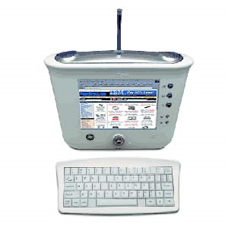
Absence-of-errors fallacy
3Com Audrey

Slide 40
Fundamentals Test Process
Planning and control
Analysis and design
Implementation and execution
Evaluating exit criteria and reporting
Test closure activities

Slide 41
Test Plan
A document describing the scope, approach, resources and schedule of intended test activities
Identifies test items, features to be tested, testing tasks and responsibilities, test environment &
Risk analysis – contingency planning

Slide 42
Test Monitoring
Periodically checking the status of test project
Monitor, maintain and compare the actual test results to what was planned

Slide 43
Test Conditions
An item or event of a component or system that could be verified by one or more test cases.
Example A function, transaction, feature, quality attribute, or structural element

Slide 44
Test Basis
All documents from which the requirements of a component or system can be inferred.

Slide 45
Test Data
Data that exists (for example, in a database) before a test is executed, and that affects or is affected by the component or system under test.

Slide 46
Coverage (Test Coverage)
The degree, expressed as a percentage, to which a specified coverage item has been exercised by a test suite.

Slide 47
Test Procedure Specification
Test procedure, test script, manual test script
A document specifying a sequence of actions for the execution of a test.

Slide 48
Test Suite
A set of several test cases for a component or system under test,
Where the post condition of one test is often used as the precondition for the next one

Slide 49
Test Execution
The process of running a test on the component or system under test, producing actual result or results

Slide 50
Test Approach
The implementation of the test strategy of a specific project. It typically includes the decisions made that follow based on the (test) project’s goal and the risk assessment carried out, starting points regarding the test process, the test design techniques to be applied, exit criteria and test types to be performed

Slide 51
Incident
Any event occurring that requires investigation is an incident

Slide 52
Testware
Artifacts produces during the test process required to plan, design, and execute tests, such as documentation, scripts, inputs, expected results, set-up and clear-up procedures, files, databases, environment, and any additional software or utilities used in testing

Slide 53
Regression Testing
Testing of previously tested program following modification to ensure that defects have not been introduced or uncovered in unchanged areas of the software, as a result of the changes made.
It is performed when the software or its environment is changed.

Slide 54
Exit Criteria
The set of generic and specific conditions, agreed upon with the stakeholders, for permitting a process to be officially completed.
The purpose of exit criteria is to prevent a task from being considered completed.
Exit criteria tells when to stop testing

Slide 55
Test Log
Test log is a chronological record of relevant details about the execution of tests

Slide 56
Test Summary Report
A document summarizing testing activities and results.
It also contains an evaluation of the corresponding test items against exit criteria.

Slide 57
The Psychology of Testing
Error guessing
Independence of testing
Testing policy

Slide 58
Error Guessing
A test design technique where the experience of the tester is used to anticipate what defects might be present in the component or system under test as a result of errors made, and to design test specifically to expose them

Slide 59
Independence of Testing
Separation of responsibilities, which encourages the accomplishment of objective testing

Slide 60
Test Policy
A high level document describing the principles, approach and major objectives of the organization regarding testing.

Slide 61
Questions - 1. Fundamentals of Testing
1. A company recently purchased commercial off-the-shelf application to automate their bill paying process. They now plan to run an acceptance test against the package prior to putting it into production. Which of the following is their most likely reason for testing?

Slide 62
1. Fundamentals of Testing – Question 1 answers
a. To build confidence in the application.
b. To detect bugs in the application.
c. To gather evidence for a lawsuit.
d. To train the users.

Slide 63
1. Fundamentals of Testing – Question 2
According to the ISTQB Glossary, the word ‘bug’ is synonymous with which of the following words
a. Incident.
b. Defect.
c. Mistake.
d. Error.

Slide 64
1. Fundamentals of Testing – Question 3
According to the ISTQB Glossary, a risk relates to which of the following?
a. Negative feedback to the tester.
b. Negative consequences to the tester.
c. Negative consequences that could occur.
d. Negative consequences for the test object

Slide 65
1. Fundamentals of Testing – Question 4
Ensuring that test design starts during the requirements definition phase is important to enable which of the following test objectives?
a. Preventing defects in the system.
b. Finding defects through dynamic testing.
c. Gaining confidence in the system.
d. Finishing the project on time.

Slide 66
1.Fundamentals of Testing – Question 5
A test team consistently finds between 90% and 95% of the defects present in the system under test. While the test manager understands that this is a good defect-detection percentage for her test team and industry, senior management and executives remain disappointed in the test group, saying that the test

Slide 67
1.Fundamentals of Testing – Question 5
Team misses too many bugs. Given that the users are generally happy with the system and that the failures which have occurred have generally been low impact, which of the following testing principles is most likely to help the test manager explain to these mangers and executives why some defects are like to be missed?

Slide 68
1.Fundamentals of Testing – Question 5 – answers
a. Exhaustive testing is impossible.
b. Defect clustering.
c. Pesticide paradox.
d. Absence-of-errors fallacy.

Slide 69
1.Fundamentals of Testing – Question 6
According to the ISTQB Glossary, regression testing is required for what purpose?
a. To verify the success of corrective actions.
b. To prevent a task from being incorrectly considered completed.

Slide 70
1.Fundamentals of Testing – Question 6 - answers
c. To ensure that defects have not been introduced by a modification.
d. To motivate better unit testing by the programmers.

Slide 71
1.Fundamentals of Testing – Question 7
Which of the following is most important to promote and maintain good relationships between testers and developers?
a. Understanding what managers value about testing.
b. Explaining test results in a neutral fashion

Slide 72
1.Fundamentals of Testing – Question 7 - answers
c. Identify potential customer work-arounds for bugs.
d. Promoting better quality software whenever possible.

Slide 73
1.Fundamentals of Testing – Question 8
Which of the statements below is the best assessment of how the test principles apply across the test life cycle?
a. Test principles only affect the preparation for testing.
b. Test principles only affect test execution activities.

Slide 74
1.Fundamentals of Testing – Question 8 - answers
c. Test principles affect the early test activities such as review.
d. Test principles affect activities throughout the test life cycle.

Slide 75
References
Foundations of Software Testing by:
Rex Black, Erik Van Veenendaal, and Dorothy Graham… Third Edition
Software Testing A Craftman’s Approach by Paul C. Jorgensen .. Fourth Edition

Slide 76
Reminders
Select & email Research Paper topic – Sep 29th
Midterm Exam on Oct 6th (Closed books/notes/no cell phones/laptops)
Submit Research Paper Outline by Oct 20th
No class on November 24th
Final Exam – Group Presentations December 1st and December 8th

Slide 77
Midterm Exam
Midterm Exam
October 6th
In class – short questions,
multiple choice and true or false Closed books/notes/no phone or laptop use
(30 Points)

Slide 78
Research Paper Topics – select one
Software Testing – SDLC/STLC
White-box/Black-box testing
Select any Testing tool (Automation)
Test Management
Software Maintenance/ Regression Testing
Outline is due Oct 20th and Research Paper due on Nov 17th (40 points)

Slide 79
Final is Group Project Presentation
Group presentation in Class on Dec 1st and 8th (depending number of students for in class presentation)
Select topics per your group collaboration related to testing and or maintenance
Each group will get 20 minutes. Each individual needs to present their own presentation 5minutes (30 points)

Slide 80
Contact information
Nazneen Hashmi
Cell 312-498-8387
Call or Text me for appointments
Email: nhashmi@iit.edu

